Slide 1

Data Wrangling

Slide 2
Objectives
Implement data wrangling
Student complete the missing code
Data Wrangling

Slide 3
Implement Data Wrangling
Import and complete the following Jupyter notebook in IBM Watson Studio:
  labs-jupyter-spacex-Data 20wrangling.ipynb
→ Student task: complete the missing and show your results
Objectives:
  Exploratory Data Analysis
  Determine Training Labels
Data Wrangling
Notes:
https://cf-courses-data.s3.us.cloud-object-storage.appdomain.cloud/IBM-DS0321EN-SkillsNetwork/labs/module_1_L3/labs-jupyter-spacex-Data%20wrangling.ipynb

Slide 4
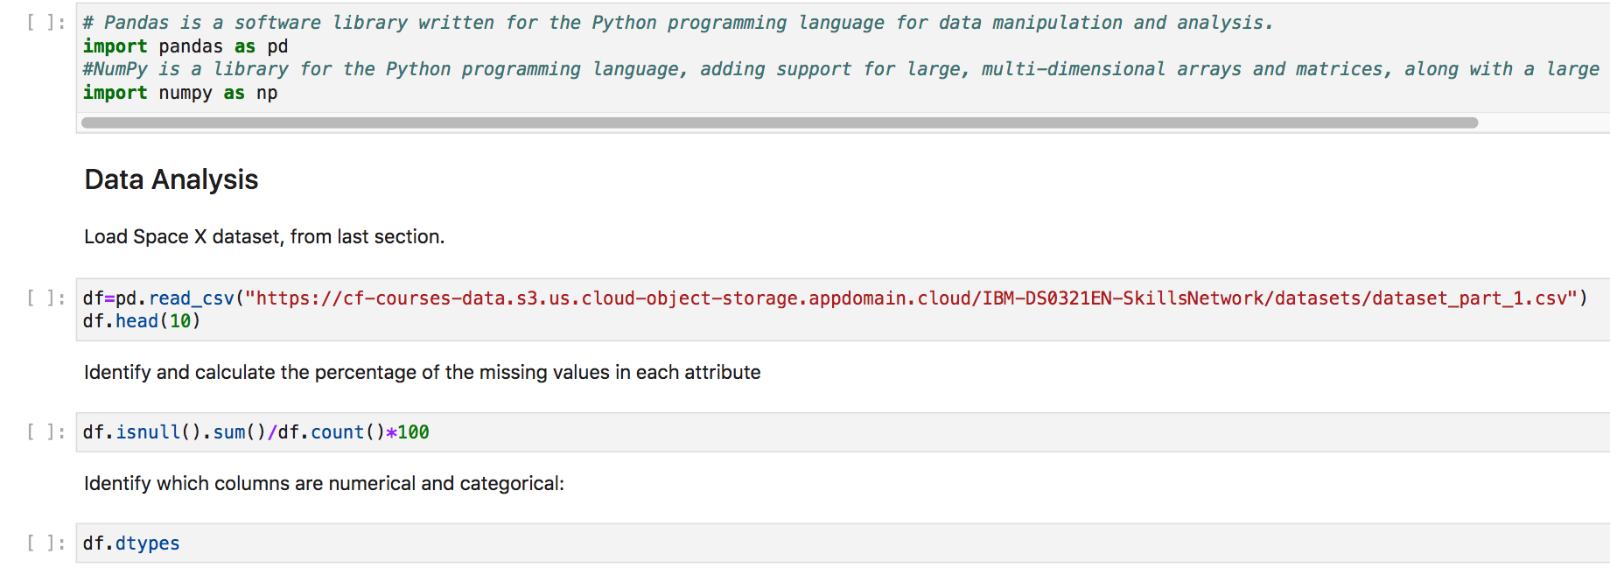
Implement Data Wrangling
Data Wrangling

Slide 5
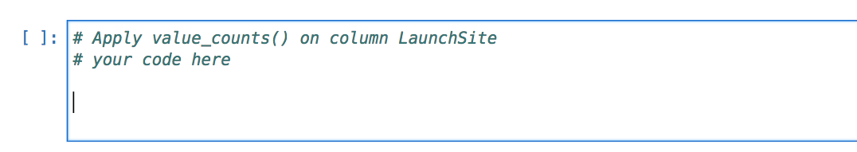
Implement Data Wrangling
TASK 1: Calculate the number of launches on each site
Data Wrangling

Slide 6
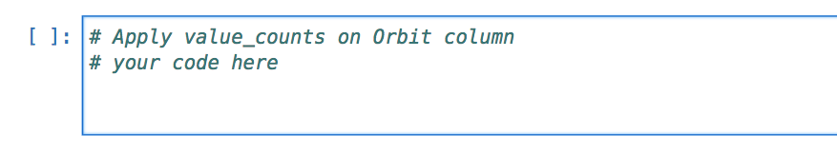
Implement Data Wrangling
TASK 2: Calculate the number and occurrence of each orbit
  Use the method .value_counts() to determine the number and occurrence of each orbit in the column Orbit
Data Wrangling

Slide 7
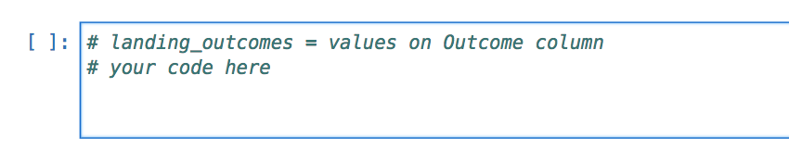
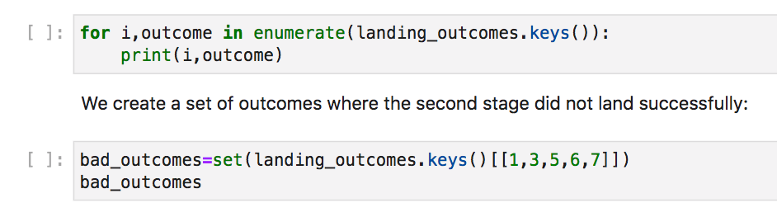
Implement Data Wrangling
TASK 3: Calculate the number and occurrence of mission outcomes per orbit type
  Use the method .value_counts() on the column Outcome to determine the number of landing_outcomes.
  Then assign it to a variable landing_outcomes.
Data Wrangling

Slide 8
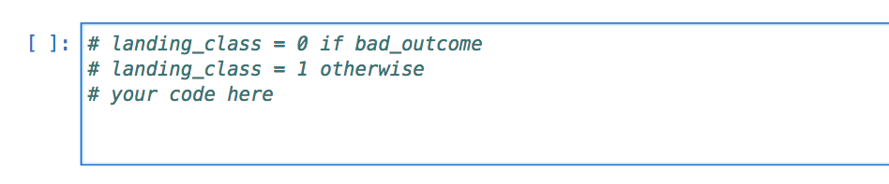
Implement Data Wrangling
TASK 4: Create a landing outcome label from Outcome column
Data Wrangling

Slide 9
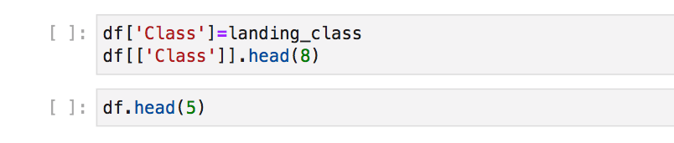

Implement Data Wrangling
Determine the success rate:
Data Wrangling

Slide 10

Implement Data Wrangling
Export to a CSV
Data Wrangling

Slide 11
Summary
Implement data wrangling
Student complete the missing code
Data Wrangling

Slide 12
Q & A
Data Wrangling

